Slide 1




Heart Attack Prediction
ML prediction project for detecting possibility of heart attack.
Submitted By
ATHUL P

Slide 2
Index
Abstract
Introduction
Existing system
Proposed system
Frontend
Backend
SVM
Deployment
Dataset
Advantages
Disadvantages
Future upgrades

Slide 3
Abstract
Heart attack is very dangerous since it may lead to instantaneous death. This proposed system predicts the possibility of a heart attack by using some of the medical data collected from the user. The system uses a supervised learning method for classification called Support Vector Machine(SVM). Using SVM a model is created from 80 percent of the dataset and tested against the remaining 20 percent of the data. Required data is collected from the user to predict the possibility of heart attack. This data is given to the model for prediction and the model gives the possibility of heart attack as output and the output is used to show the possibility of heart attack to the user.
My project is never a substitution for a doctor or any of heart attack detecting medical equipments. This project will only give an insight about the possibility of heart attack from datas collected from several people.
Support vector machines are powerful algorithms that can be used for classification and regression. SVM generate hyperplanes that segregate the classes in the best way. Then, it will choose the hyperplane that separates the classes correctly. The algorithm just classifies the data into different classifications based on the hyperplanes.

Slide 4
Machine Learning
Machine learning is a subfield of artificial intelligence, which is broadly defined as the capability of a machine to imitate intelligent human behavior.
Machine learning is a technology which enables computers to learn automatically from past data. Machine learning uses various algorithms for building mathematical models and making predictions using historical data or information.

Slide 5
Introduction
Heart Attack Prediction is a Machine Learning project created using python as front end as well as back end.
Users can enter the required medical datas to the webpage and the model process the input and the result is given as output, whether the given data indicates the person may or may not have heart attack.
Detecting heart attacks by using previously recorded trusted data is not a very common method of checking for heart attacks but it can provide an overview of whether the condition is severe or not just like the doctor evaluating the checkup data.
The objective of the SVM algorithm is to distinctly classify the data into categories. The prediction is not very accurate but it can be used as a stepping stone for early detection of heart attack and taking necessary precautions and testing.

Slide 6
Existing System
As of today there is no such existing system for early detection of Heart Attack using basic medical datas only.
Heart Attack can only be detected with the help of scientific tools and methods like,
ECG
Blood Test
X-Ray
Angiogram
MRI Scan

Slide 7
Proposed System
This proposed system predicts the possibility of a heart attack by using some of the medical data collected from the user. The system uses a supervised learning method for classification called Support Vector Machine(SVM).

Slide 8
About Frontend
Streamlit is an open-source Python library that makes it easy to create and share beautiful, custom web apps for machine learning and data science.
Streamlit provides an easy way of creating web apps without using html and css.

Slide 9
About Backend
Language : Python
Libraries : Numpy, Pandas, Seaborn, Matplotlib, Streamlit, Sklearn
Algorithm : SVM

Slide 10
What is SVM ? 🤔
Support Vector Machine or SVM is one of the most popular Supervised Learning algorithms, which is used for Classification as well as Regression problems. However, primarily, it is used for Classification problems in Machine Learning.
The goal of the SVM algorithm is to create the best line or decision boundary that can segregate n-dimensional space into classes so that we can easily put the new data point in the correct category in the future. This best decision boundary is called a hyperplane.
SVM chooses the extreme points/vectors that help in creating the hyperplane. These extreme cases are called as support vectors, and hence algorithm is termed as Support Vector Machine.

Slide 11
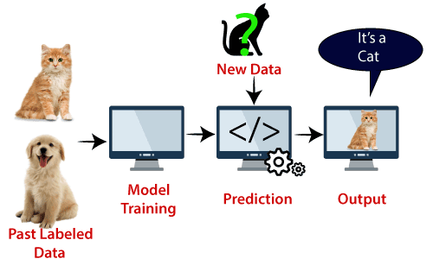
Basic
Idea
Of
SVM
🧐 !

Slide 12
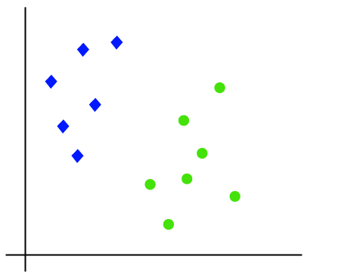
How
SVM
works ?

Slide 13
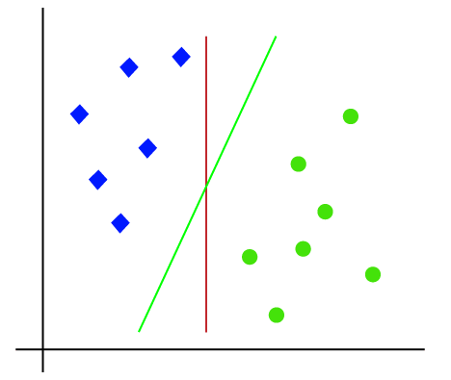
Isn’t
This
Possible
? 🤔

Slide 14
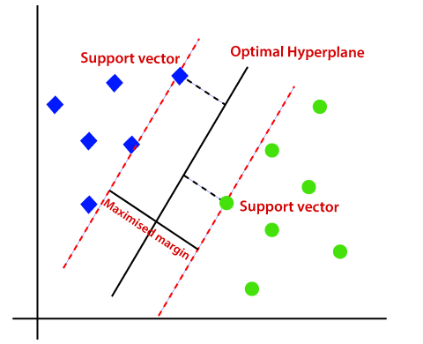
The
Correct
Way !

Slide 15
Deployment
The project is deployed in a deployment platform called streamlit cloud.
Streamlit cloud is an open source deploying platform for the streamlit apps.
So that it can be accessed from any device using the link provided by the streamlit cloud
Link : https://athulpreman-ml-heart-attack-prediction-home-xqztks.streamlit.app/

Slide 16
Dataset
Age
Sex
Chest pain type
Resting blood pressure
Cholesterol
Fasting blood sugar
Abnormality in ECG(y/n)
Maximum heart rate achieved
Regularly exercise(y/n)
Any major vessel damaged(count)
The dataset used is a csv file which has the records of 344 heart patients.
The dataset has the following details of the heart patients.

Slide 17
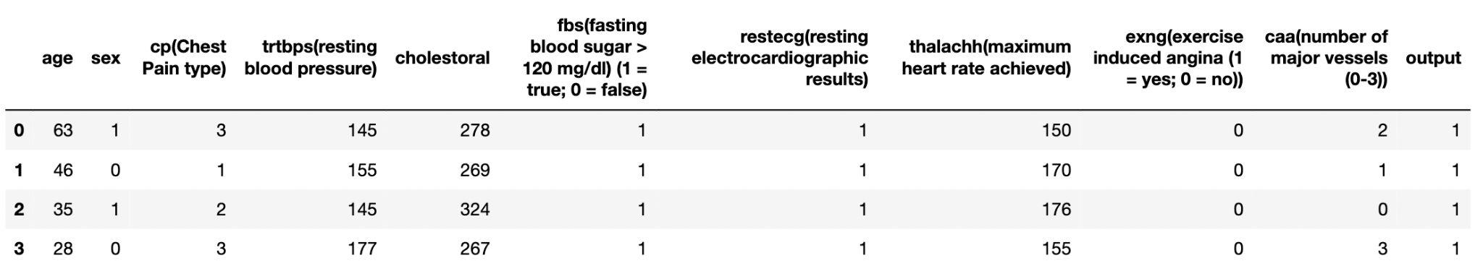
Sample Data
Sample Data

Slide 18
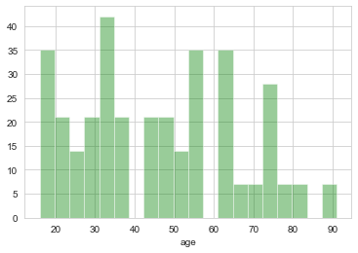
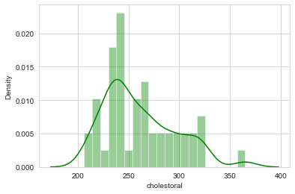
Analytics
Of Dataset
01
A good analytics provide a good insight about the data.

Slide 19
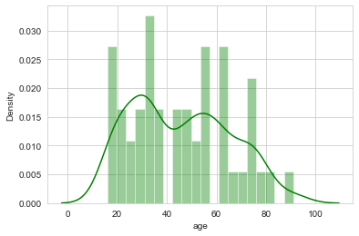
Analytics
Of Dataset
02
A good analytics provide a good insight about the data.

Slide 20
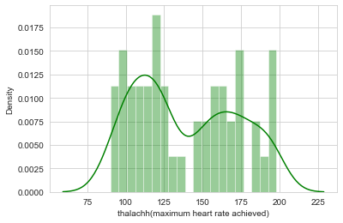
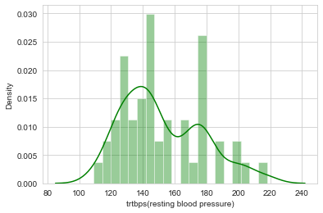
Analytics
Of Dataset
03
A good analytics provide a good insight about the data.

Slide 21
Accuracy
60%
For a ML prediction project accuracy plays a crucial role.
Accuracy of the prediction depends on the accuracy of the model.
Accuracy of the model depends on the dataset it uses.
Accuracy of the model

Slide 22
Advantages
Early prediction of heart attack is possible.
Easily accessible in all devices with internet by using the link.
Can save time of consulting doctor before all the testing.
Easy and time saving methodology.

Slide 23
Limitations
Record count in dataset.
Accuracy is average.
Extreme values are needed for more precise prediction.
In some cases there is some possibility that prediction may go wrong.

Slide 24
Future Upgrades
Elimination of consulting doctor.
Increasing the accuracy by increasing record count.

Slide 25
Lets Move To The Project !

